Slide 1
College Admissions Algorithms
Eric Liu

Slide 2
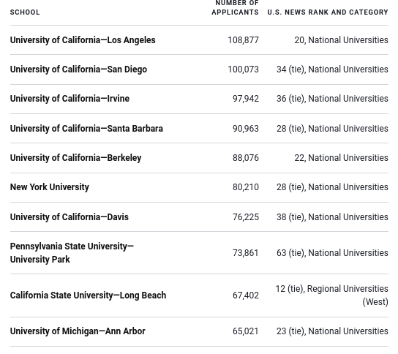
College Admissions
700+ Colleges
4 million applications sent (non-unique)
Top 10 schools averaged over 80k applications
Harvard received 40k in 2020
Notes:
https://www.usnews.com/education/best-colleges/the-short-list-college/articles/colleges-that-received-the-most-applications

Slide 3
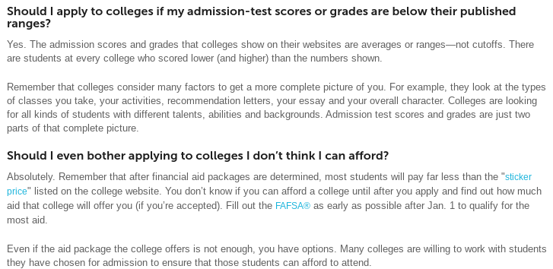
Why are Applications going up?
Common App (electronic) makes logistics of applying to multiple schools easier
General increased awareness of applying to college
Societal effect of job applications requiring a college degree
Students are encouraged to apply to more colleges
More awareness of smaller or specialized schools
Notes:
https://www.usnews.com/education/best-colleges/the-short-list-college/articles/colleges-that-received-the-most-applications
https://bigfuture.collegeboard.org/get-in/applying-101/applying-to-college-faq#:~:text=Each%20year%2C%20nearly%20a%20million,than%2030%20colleges%20and%20universities.

Slide 4
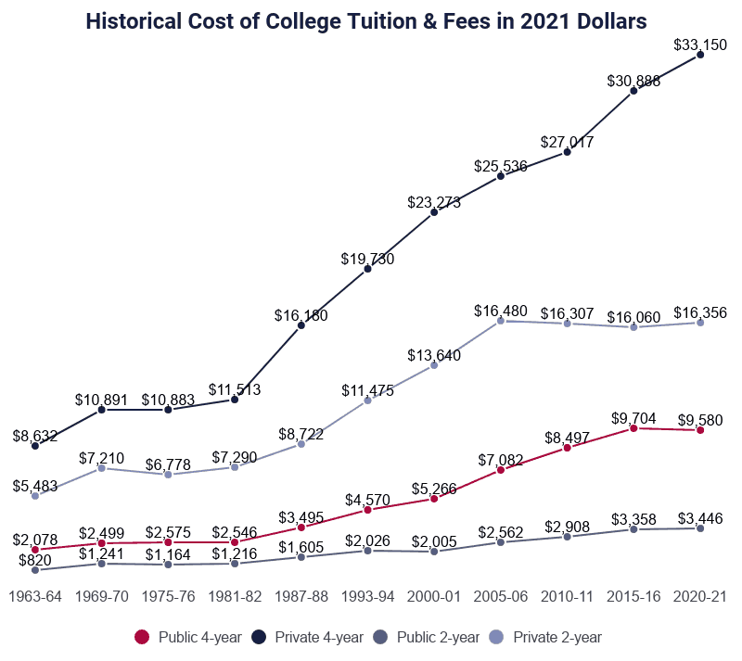
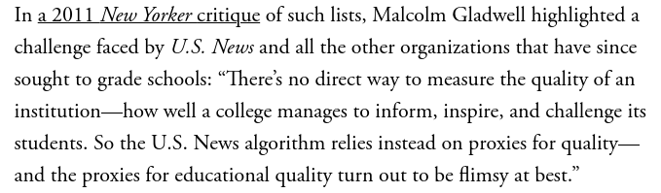
Gaming the ranking algorithm
Admissions rate was part of USNews algorithm until ~2018
What do you think happened with the admissions rate?
Faculty salary is part of the ranking ? What will happen then?
New algo is more results based...
Notes:
https://www.latimes.com/opinion/story/2021-10-04/college-admissions-record-applications
https://www.usnews.com/education/best-colleges/articles/how-us-news-calculated-the-rankings
https://www.washingtonpost.com/education/2018/09/12/us-news-changed-way-it-ranks-colleges-its-still-ridiculous/
https://www.newyorker.com/magazine/2011/02/14/the-order-of-things

Slide 5
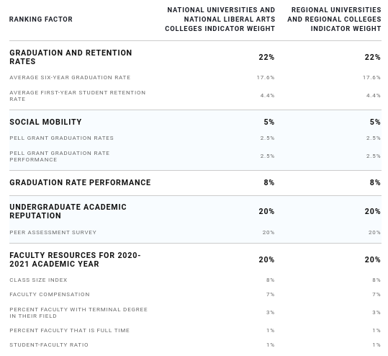
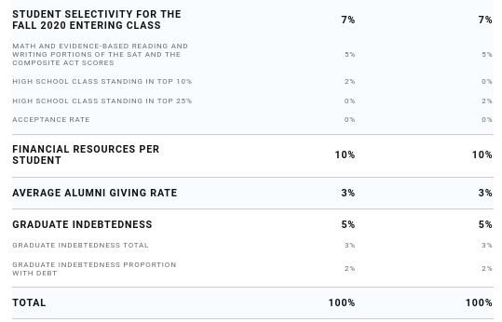
US News Rankings
How would you game this algorithm?
Notes:
https://www.usnews.com/education/best-colleges/articles/how-us-news-calculated-the-rankings

Slide 6
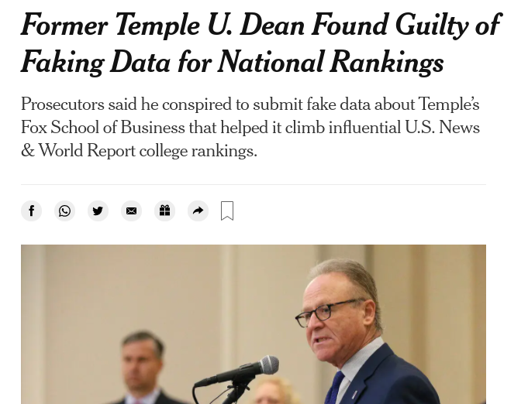
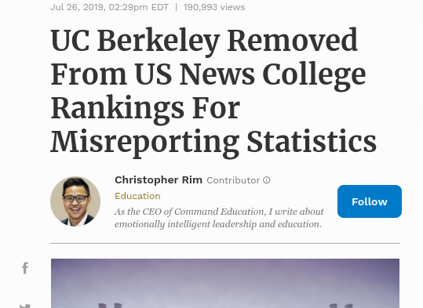
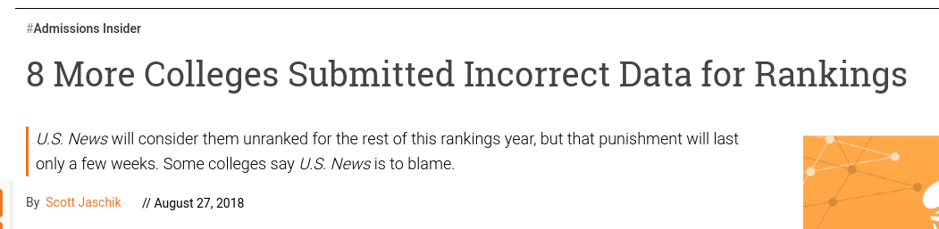
Notes:
https://www.forbes.com/sites/christopherrim/2019/07/26/uc-berkeley-removed-from-us-news-college-rankings-for-misreporting-statistics/?sh=5b3e4c1a7578
https://www.nytimes.com/2021/11/29/us/temple-university-moshe-porat-fraud.html
https://www.insidehighered.com/admissions/article/2018/08/27/eight-more-colleges-identified-submitting-incorrect-data-us-news

Slide 7
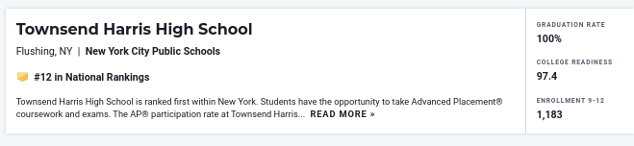
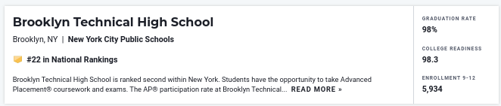
High School Rankings
Notes:
https://www.usnews.com/education/best-high-schools/articles/how-us-news-calculated-the-rankings
https://patch.com/new-york/bed-stuy/brooklyn-high-school-named-2nd-best-state-u-s-news
https://www.usnews.com/education/best-high-schools/national-rankings

Slide 8
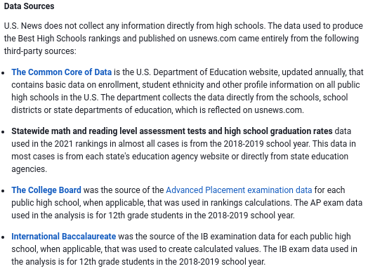
High School Rankings Algorithm

Slide 9
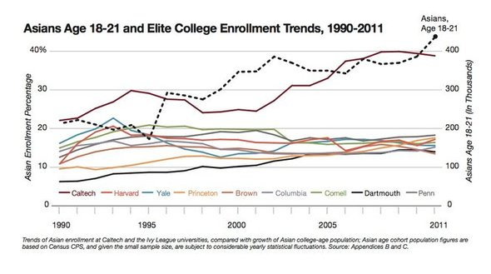
Asian Quota

Slide 10
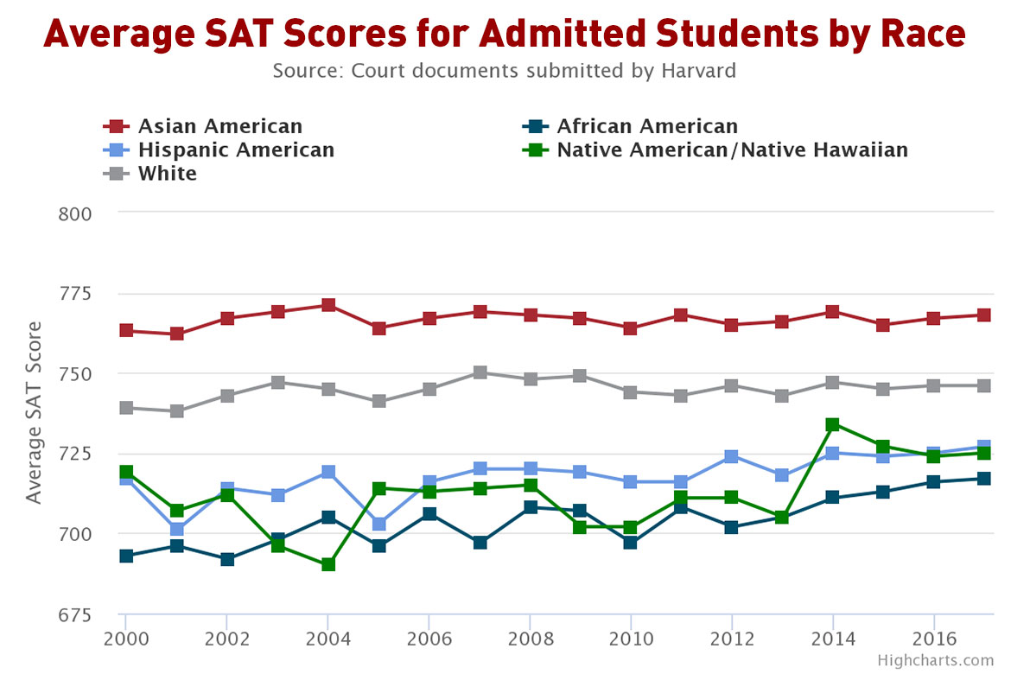
Asian Quota

Slide 11
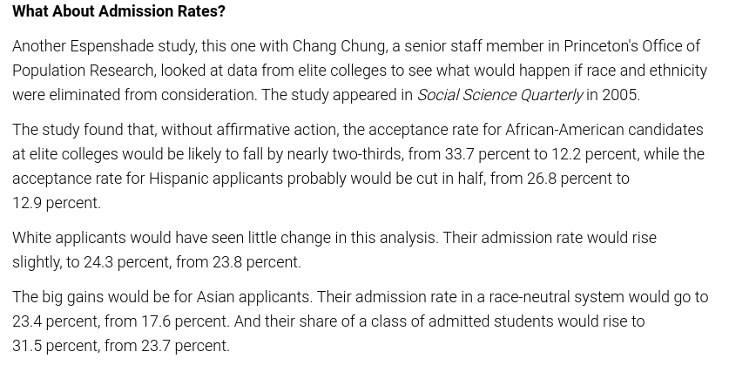
What would happen in race-blind admissions?
Notes:
https://www.insidehighered.com/admissions/article/2017/08/07/look-data-and-arguments-about-asian-americans-and-admissions-elite

Slide 12
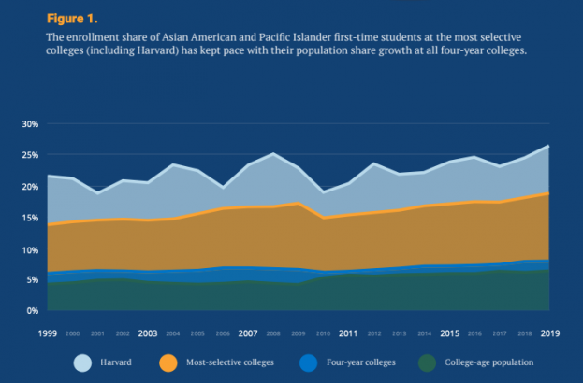
Are the data and studies correct?
Notes:
https://www.the74million.org/new-study-finds-no-asian-american-discrimination-in-admissions-at-elite-colleges/

Slide 13
Program
Admission Algorithm
Given list of students and data on the categories below
Grades / GPA
AP Exams / Honors Grades
SAT / Standardized exam
Extracurriculars
Personal Essay / Story
Each category can be given a specific weight. Default weights but can be changed
Students will be ranked according to weights and their data.

Slide 14
Q&A
Some Q’s to keep in mind or to discuss
Do you keep your algorithm simple? Rating of 1-10 in 5 categories? Or add more complexities to help refine your search?
Should algorithms be made public?
How do you remove as much bias and subjectivity in the ratings?
How do you rank students to enter a seat limited program?

Slide 15
Resources
https://www.brookings.edu/research/enrollment-algorithms-are-contributing-to-the-crises-of-higher-education/
https://www.insidehighered.com/admissions/article/2021/09/27/critics-algorithms-push-admissions-wrong-direction
https://www.washingtonpost.com/outlook/next-normal-algorithms-college/2021/11/12/366fe8dc-4264-11ec-a3aa-0255edc02eb7_story.html
https://pro.admitsee.com/mainpage/algorithm
https://slate.com/technology/2021/01/higher-education-algorithms-student-data-discrimination.html
https://www.nytimes.com/roomfordebate/2012/12/19/fears-of-an-asian-quota-in-the-ivy-league/statistics-indicate-an-ivy-league-asian-quota
https://www.kuow.org/stories/whitewashing-of-asian-students-and-the-report-that-launched-a-reckoning
https://nypost.com/2020/09/12/colleges-reveal-the-secret-formula-for-deciding-who-gets-in/

